Slide 1
The Influence of Selection on Human Regulatory Elements
Diego Rivera Gelsinger
Rotation #4
Dr. James Taylor’s Lab

Slide 2

The 99.5%
Notes:
The chimpanzee has long presented a conundrum for human geneticists. The orthologous proteins of humans and chimpanzees are more than 99.5% identical, yet the two species differ profoundly across a broad spectrum of apparently unrelated phenotypes. This evident paradox led Drs King and Wilson in 1975 to speculate that differences in gene regulation, rather than protein-coding sequences, drive divergence and might primarily explain differences in physiology and behavior between humans and chimpanzees.

Slide 3
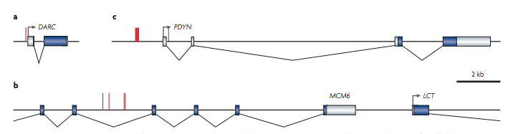
Evidence for cis-Regulatory Elements Driving Adaptation
Lactose persistance
SNP Mutations
Catalyzes Lactose to Lactase
Intron
Notes:
Most of what we know about the phenotypic impact and fitness consequences of mutations is still based on studies of coding sequencing, yet it has long been argued that mutations affecting mechanisms of gene regulation must have had a prominent role in the evolution of humans and other mammals. For example, the genetic basis for the ability of humans to digest lactose as an adult was found to be SNPs in the intron of a neighboring gene (MCM6) of LCT, the enzyme that catlyzes lactose. In this case, these SNPs increased the expression of LCT allowing persistent digestion of lactose. While globally limited, such studies have shown the importance of regulatory mutations contributing to expression differences and ecologically adaptive traits.
~~~~~~~~~~~~~~~~~~~~~~~~~~~~~~
~~~~~~~~~~~~~~~~~~~~~~~~~~~~~~
It has long been argued that mutations affecting mechanisms of gene regulation must have had a prominent role in the evolution of humans and other mammals. For several theoretical reasons, transcription factor binding sites and other cis-regulatory sequences may be particularly important in evolutionary adaptation. For example, mutations in such sequences might help to minimize the functional tradeoffs associated with evolutionary changes because these elements often primarily influence the expression of a single gene in a particular cell type or under a particular condition, whereas proteins tend to have broader effects. In addition, cis-regulatory mutations are often co-dominant (neither allele dominates), which may allow natural selection to act on them more efficiently than on protein-coding mutations.
can still equate to a large amount of adaptively evolving non-coding DNA, since non-coding DNA makes up approximately 98% of the DNA in the human genome.

Slide 4
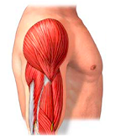
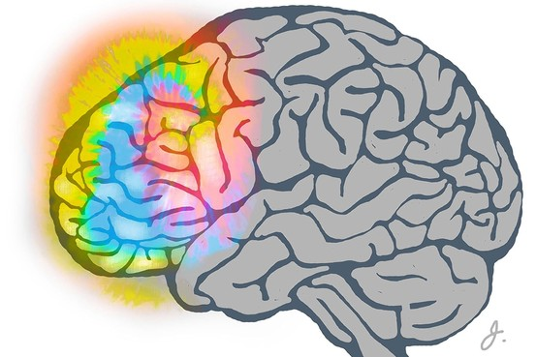
Does regulation of homologous genes drive divergence?
Goal: Find differentially expressed homologous genes between Human and Chimpanzee in different tissue types and infer the influence of selection on the regulatory regions of these genes.
Skeletal muscle:
strength
Prefrontal Cortex:
cognitive behavior
Notes:
-With recent advances in sequencing technology, large scale studies of the influence of selection on regulatory regions is now possible. With ChIP-seq and whole genome-sequences across multiple cell types and closely related species it is possible to locate conserved sites of regulatory regions (such as transcription factor binding sites) and find polymorphisms to infer natural selection on these sites.
-Using such data, my goal was to find differentially expressed homologous genes between Human and Chimpanzee in different tissue types and infer the influence of selection on the regulatory regions of these genes.
-The tissue types I looked at were skeletal muscle and the prefrontal cortex because of physiological differences in these tissues between the two closely related animals.
-I hypothesized that if regulatory regions are driving divergence between closely related species, we expect to find a substantial influence of natural selection in non-coding regions of regulatory elements that correspond to differentially expressed genes.
~~~~~~~~~~~~~~~~~~~~~~~~
Hypothesis: If regulatory machinery drives divergence between closely related species, we expect to find a high influence of natural selection in the sequence (transcription factor binding sites) of non-coding regions of cis-regulatory elements.
Regions to study this can be transcription factor binding sites, histone methylation sites, and non-coding RNAs
Need interspecies variation and ancestral nucleotide state
arguments on the recognition that the proper function of every gene depends on two distinct components: what its product does and the circumstances under which that product is produced. A perfectly good enzyme can be useless or even counterproductive if synthesized under the wrong conditions.

Slide 5
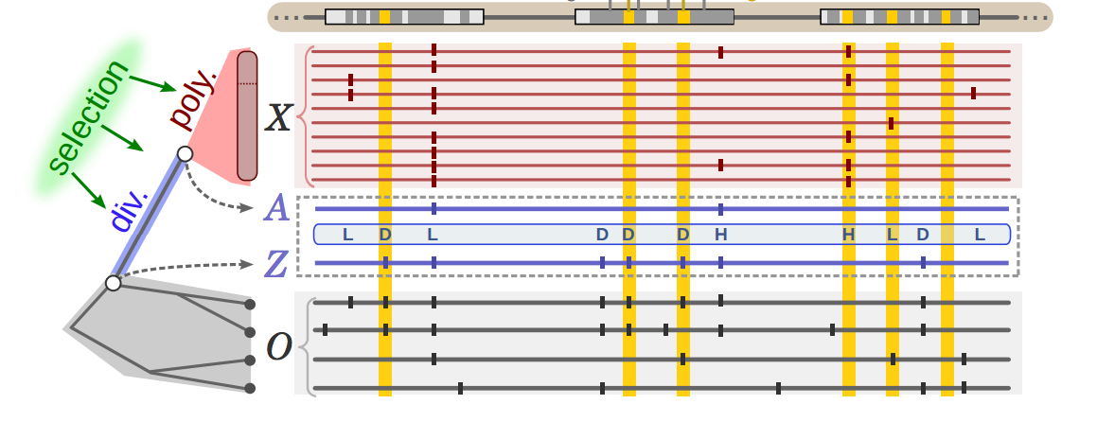
INSIGHT (Inference of Natural Selection from Interspersed Genomically coHerent elemenTs)
Blocks
Blocks
Blocks
N
N
N
Influence of
D
D
D
D
D
D
D
D
D
Phylogenetic
Ancestry
Notes:
To find the inference of selection on regulatory sites I used a new probabilistic method developed by the Siepel lab. The method measures the influence of natural selection by contrasting patterns of polymorphism (in red) and divergence (in blue) in a collection of genomic elements of interest (in gold) with those in flanking neutral sites (dark gray).The comparison of these component determines whether sites are considered to be divergent (D). Inference is based on differences in the patterns of polymorphism and divergence expected at neutral and selected sites all in reference to an phylogenetic ancestral site from closely related outgroups.
~~~~~~~~~~~~~~~~~~~~~~~~~~~~~~
~~~~~~~~~~~~~~~~~~~~~~~~~~~~~~
Precomputed summaries:
-Polymorphism data
-Outgroup sequence data and ancestral priors --- A prior distribution for the ancestral state (Z)
-Filters: autosomes only,
-Putative neutral sites: remove sites likely to be under selection
-Genomic blocks: 10 kb overlapping windows based on putative neutral sites -> get neurtal polymorphism rate and neutral divergence rate
Nucleotide sites in both elements and flanks are grouped into genomic blocks of a few kilobases in length to accommodate variation along the genome in mutation rate and coalescence time. The model consists of phylogenetic, recent divergence , and intraspecies polymorphism components, which are applied to genome sequences for the target population and outgroup species

Slide 6
Influence of Selection Analysis Pipeline
RNA-seq
Differential Expressed Genes (Human genes relative to Chimp)
Statistically significant (False Discovery Rate < 5%)
Tissue-enriched genes (The Human Protein Atlas)
Data
Filtering
Down-regulated
Up-regulated
Data
Mining
cis-elements LINKED to a gene
DNaseI HSS specificity (ENCODE Project)
Natural
Selection
Analysis
INSIGHT
(precomputed summaries of human polymorphism on transcription
factor binding sites for 55 diverse human genomes)
Notes:
My analysis pipeline to achieve this was divided into 4 parts:
First I did an RNA-seq analysis on the respective tissue type to find differentially expressed genes between human and chimp.
Second, I filtered these genes into those that are significantly different and furthermore to only genes that have been exprimentally tested through antibodies to be enriched in the respective tissue-type (based on the Human Protein Atlas). I will refer to these as tissue-specific genes from here on out.
Third, I mined for regulatory elements that have been experimentally linked to a gene by Dnase hypersensitive site specificity found in the ENCODE project.
Lastly, I interesected these regulatory coordinates with precomputed summaries of human polymorphism data to get transcription factor binding sites. I used this final filtered data to do the natural selection analysis.

Slide 7
Larger Degree of Differentially Expressed Genes in the Prefrontal Cortex than in Muscle between Human and Chimpanzees
Differential Expression of Homologous Genes:
Muscle
Differential Expression of Homologous Genes:
Prefrontal Cortex
Log₂ Fold Change
Log₂ Fold Change
Mean Expression
Human changes relative to chimp
Mean Expression
Notes:
Looking at the RNA-seq data I found that both muscle and prefrontal cortex-tissue have a substantial amount of differentially expressed genes. I am visualizing the expression profile differences with an MA plot, where the y-axis is log_fold change and the x-axis is mean expression. The dots corresponds to all homologous differentially expressed gene between human and chimps, and any dot that is marked red is one that is significantly different based on a statistical cutoff of a false discovery rate less than 5%. I see that in total there are more significant differentially expressed genes in the prefrontal cortex, which is intuitive based on apparent cognitive differences between human and chimps.

Slide 8
Human Brain Tissue Exhibits More Up-regulation of Tissue-Specific Genes than in Muscle Tissue
Up-regulated
Up-regulated
Down-
regulated
Down-
regulated
Notes:
Filtering that data to tissue enriched genes, I find that there are more of them enriched in the prefrontal cortex. Both tissue-types have more up-regulated tissue-enriched genes, but the prefrontal cortex has a larger discrepancy between it’s up- and down-regulated genes.

Slide 9
Larger proportion of Regulatory Elements of Brain-specifc Genes are Under Selection
Muscle Promoter
Brain Promoter
Muscle Enhancer
Brain Enhancer
Up-regulated Tissue-Specific Genes
Fraction of sites under selection within functional elements
Down-regulated Tissue-Specific Genes
Notes:
Looking at two types of regulatory regions, promoters and enhancers, I find that there is a higher fraction of sites in these elements that are under the influence of selection for both up- and down-regulated brain-enriched genes compared to the muscle. Moreover, in up-regulated genes on both tissue types there are more fraction of sites under selection on the promoters, but for down-regulated genes the enhancers tend to have a higher fraction of sites under selection.

Slide 10
Opposite Selection Influence on Promoters and Enhancers of Up-regulated Tissue-specific Genes
Normalized:
E[A]/kbp
E[W]/kbp
Muscle
Brain
Muscle
Brain
E[A]
E[W]
Notes:
Next I looked at the influence of positive versus negative selection. I find that the enhancers of up-regulated muscles genes have more sites under a stronger influence of positive selection, while more negative selection on the promoter transcription factor binding sites.
The opposite is apparent for up-regulated brain genes, where promoters have more sites under positive selection and more negative selection for brain enhancers.

Slide 11
Negative Selection is More Influential on All Regulatory Elements of Down-regulated Tissue-specific Genes
Normalized:
E[A]/kbp
E[W]/kbp
Muscle
Brain
Muscle
Brain
E[A]
E[W]
Notes:
Looking at down-regulated genes, I see that overall there is more negative selection on both promoters and enhancer regulatory regions of both muscle and prefrontal cortex tissue types. Similarily to up-regulated genes, there are more total sites in regulatory regions of the brain that are under selection.

Slide 12
Summary
More differentially expressed genes in the prefrontal cortex
Higher proportion of regulatory regions under selection in the brain compared to muscle
Down-regulated genes show influence of negative selection in all regulatory elements of tissue-specific genes
Up-regulated genes in both tissue types show a converse relationship of positive and negative selection on regulatory regions
Influence of natural selection on regulatory sites suggests regulatory elements in specific tissues play a prominent role in the evolution of humans
Notes:
-In summary, I found that there are more differentially expressed genes in the prefrontal cortex in humans relative to chimp compared to muscle tissue
-A higher proportion of sites of the regulatory regions acting on these differentially expressed genes are under selective pressure in the brain compared to the muscle.
-When looking at down-regulated genes in both tissue types, overall the regulatory elements have more sites under negative selection
-What I think is the most interesting result is I found that up-regulated genes in both tissue types show a converse relationship of positive and negative selection on regulatory regions
-This all shows that there is an influence of natural selection in these non-coding regulatory regions which suggests regulatory elements in specifictissues play a prominent role in the evolution of humans.

Slide 13
Acknowledgements
Taylor Lab
Mike Sauria
Nitesh Turaga
Enis Afgan
Min Hyung Cho
Dr. James Taylor
YUE Lab
ENCODE Project
INSIGHT Team
Notes:
----- Meeting Notes (5/13/15 14:49) -----
Conclusion summary slides
up vs down regulation
positive and negative selection

Slide 14
Questions?

Slide 15
Future Directions
Functional consequences of positive & negative selection on regulatory sites
Txn factor binding strength
Other regulatory elements
Splicing, post-transcriptional regulation and other forms of gene regulation
Genome-wide analysis, more tissue types
Notes:
Ultimately we want to know the functional consequences of having positive or negative selection on a regulatory site. One way to test this is by using ChIP-seq data and biophysical predictive models (such as STAP) to determine the binding affinity of transcription factors to these regulatory sites that are under selection and see if it changes based on negative or positive selection.
Also, we have only considered a small fraction of regulatory elements and I have not considered regulatory elements involved in splicing, post-transcriptional regulation and other forms of gene regulation.
This means that doing a genome-wide analysis of these other non-coding regions can add up to a large portion of selection across the entire genome.

Slide 16
Opposite Selective Pressure for Functional Clusters of Promoters and Enhancers of Up-regulated Muscle-Specific Genes
Notes:
----- Meeting Notes (5/13/15 14:49) -----
# sites per kilobase of enhancer, put that on there

Slide 17
Postive Selection Drive Adaptive Substitutions in Promoters of Up-Regulated Brain-specific Genes
Notes:
----- Meeting Notes (5/13/15 14:49) -----
summary vs future directions
several more steps
don't know ancestral state

Slide 18
Negative Selection influences Regulatory Regions of Down-regulated Muscle-Specific Genes

Slide 19
Polymorphic Sites in Regulatory Regions of Down-regulated Brain Genes are Subject to Negative Selection

Slide 20
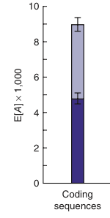
E[A] per Kilobase

Slide 21
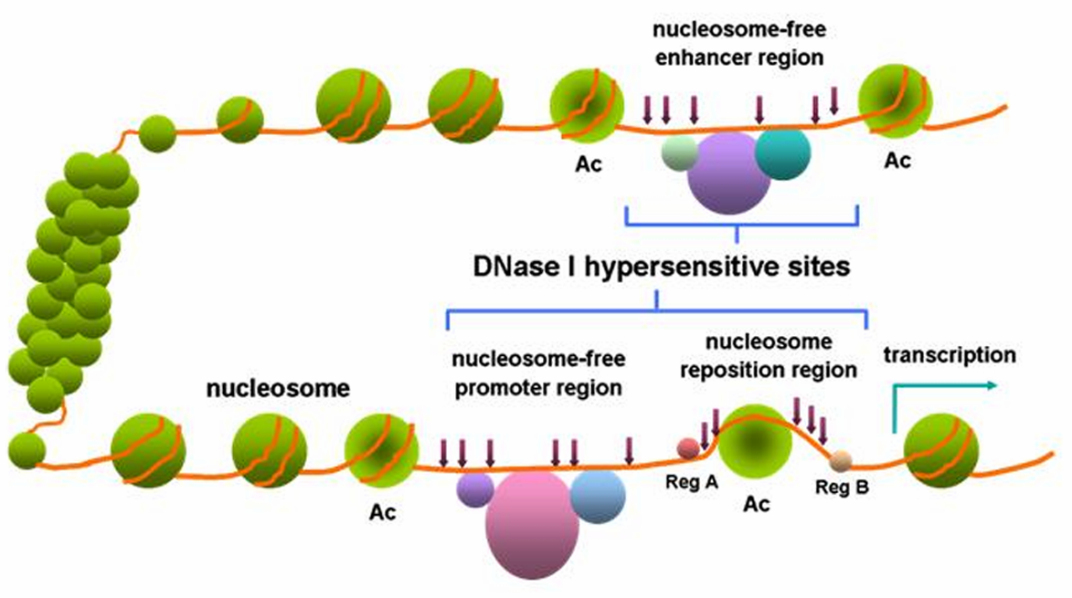
DNase I hypersensitive sites: measurement of promoter-enhancer sites
Distal
Proximal
Notes:
Find out how these sites were categorized as proximal vs distal
All DNase peaks from the above 14 cell lines were merged to form non­overlapping DNase­hypersensitive regions.
The merged DNase­hypersensitive regions were separated into TSS­proximal and TSS­distal groups based on whether or not they intersected a 2000­bp window centered on any GENCODE TSS (V19; gencode.v19.TSS.notlow.gff).
For each proximal and distal DNase­hypersensitive region, the DNase peak with the maximum score was labeled as a “master peak”
For each of the distal and proximal DNase master peaks, overlapping TF ChIP­seq peaks across all cell types (not restricted to above 14 cell lines) were identified. The TF peaks with maximum score in each master DNase peak

Slide 22
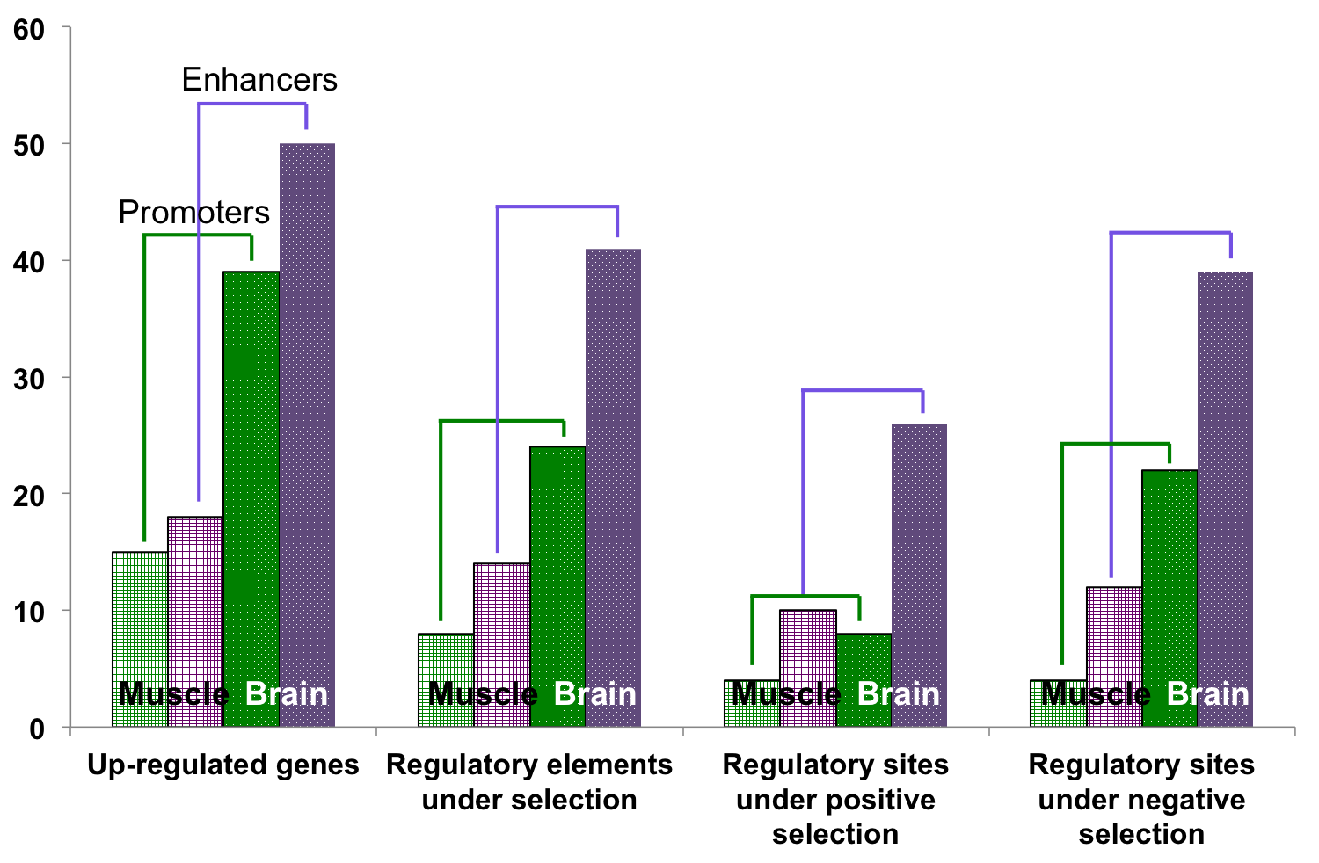
Negative Selection is more influential on Regulatory Elements of Down-regulated Brain Genes than Muscle Genes
Enhancers
Promoters
Number of Elements Under Selection
-More negative selection on enhancers of down-regulated brain genes, same for promoters
-Mixed selection for muscle-promoters
-slightly more negative selection for muscle enhancers
Notes:
-More negative selection on enhancers of down-regulated genes brain tissue.
-More negative selection on promoters of down-regulated genes in brain tissue.
-Mixed selection for muscle-promoters.
-More negative selection for muscle enhancers.

Slide 23
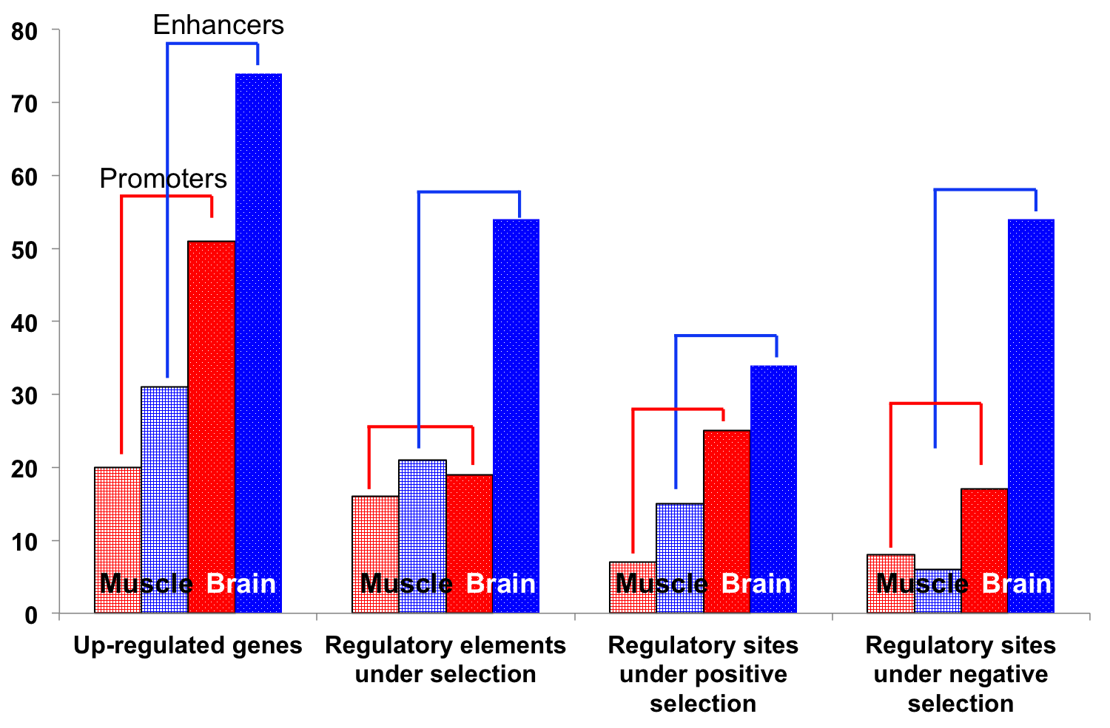
Larger proportion of Regulatory Elements of Up-regulated Brain Genes are Under Selection
Enhancers
Number of Elements Under Selection
Promoters
-Higher proportion regulatory regions for up-regulated genes under selection in the brain compared to muscle
-Enhancers of up-regulated muscle genes are under a stronger influence of positive selection, equal (mixed selection) for muscle promoters
-Promoters of up-regulated brain genes are under a stronger influence of positive selection, opposite for brain enhancers
Notes:
More regulatory regions with positive selection in brain compared to muscle (both promoters and enhancers.
-There are more regulatory regions with positive selection in the brain compared to muscle (both promoters and enhancers).
-Enhancers of up-regulated brain genes are under a stronger influence of negative selection.
-Enhancers of up-regulated muscle genes are under a stronger influence of positive selection.
-Opposite is apparent for promoters (brain promoters influenced more by positive selection vs muscle promoters).
----- Meeting Notes (5/13/15 14:49) -----
Put promoters and enhancers next to each other
Rescale based on muscle vs brain by dividing
legend rather than lines

Slide 24
Natural Selection Parameters
Up-regulation
Down-regulation
ρ
Fraction of sites under
selection within
functional elements
E[A]
Sites under
positive selection
(adaptive substitutions)
E[W]
Sites under
negative selection
Notes:
The parameters I will for up-regulated and down-regulated tissue-specific genes from both tissue types are: the fraction of sites under selection within functional regulatory elements, from these sites, the number that are under positive selection (also known as adaptive substitutions), and lastly the sites under negative selection.

